Slide 1
Agile EA Frameworks And Methodologies

Slide 2
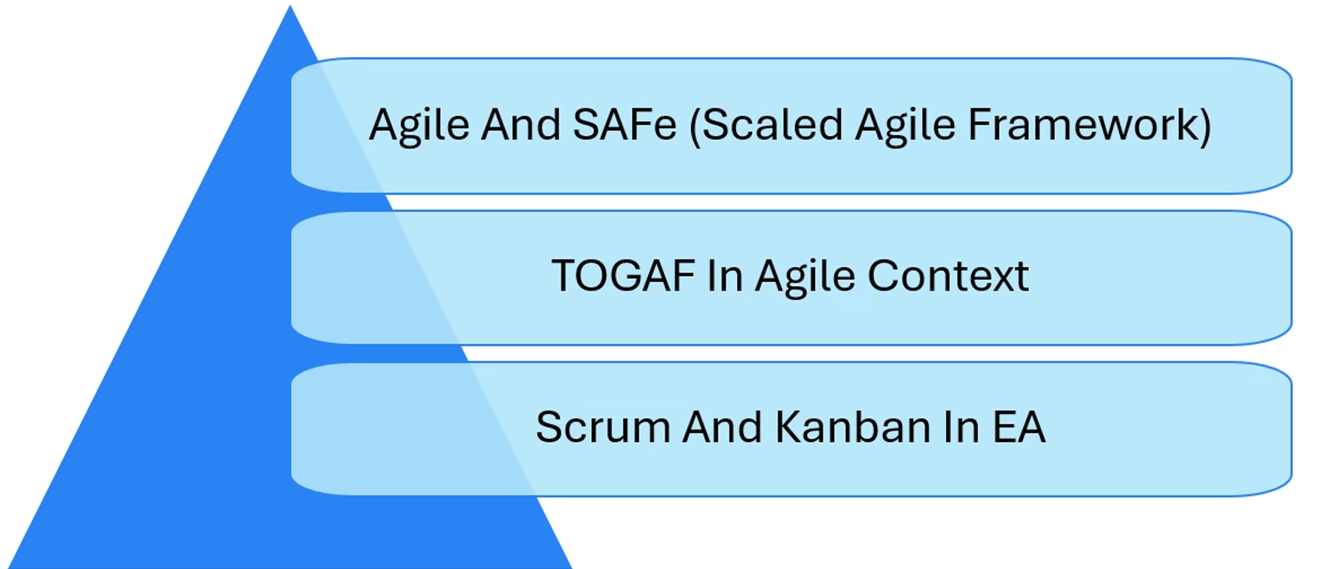
Agile EA Frameworks And Methodologies

Slide 3
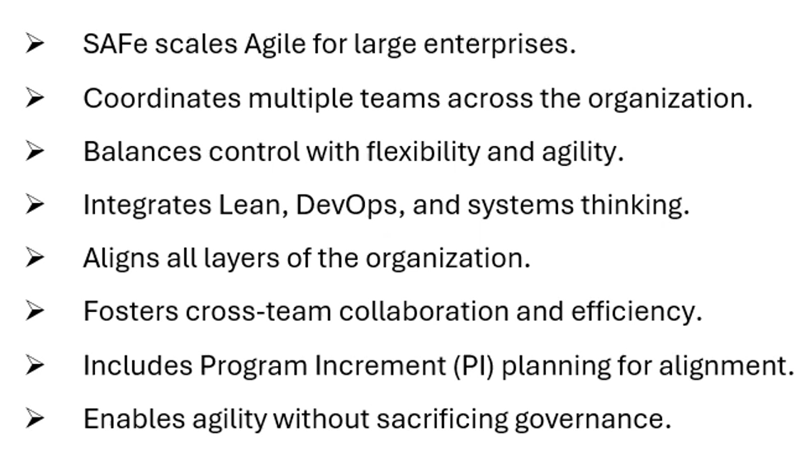
Agile And SAFe (Scaled Agile Framework)

Slide 4
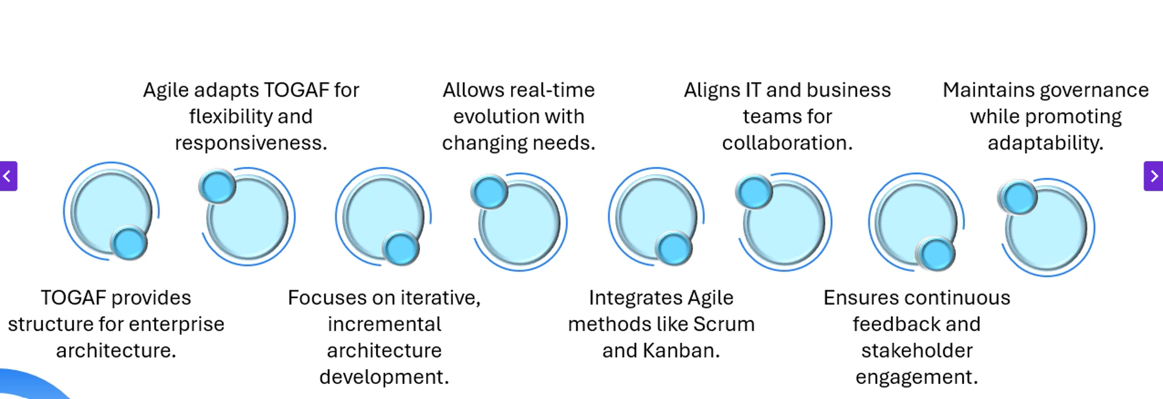
TOGAF In Agile Context

Slide 5
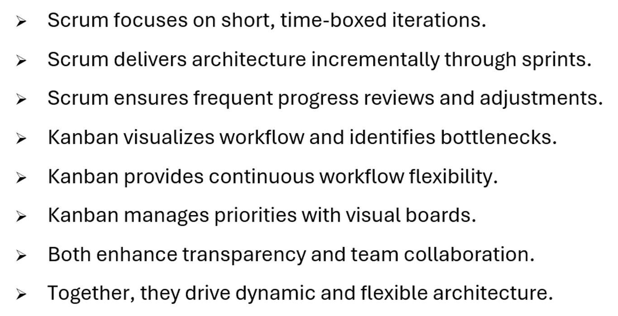
Scrum And Kanban In EA

